Slide 1
Easy Tree-sy Everyday Applications of Decision Trees
CAS Ratemaking and Product Management
San Diego, CA
March 2017
Linda Brobeck <lbrobeck@pinnacleactuaries.com>
Peggy Brinkmann <peggy.brinkmann@milliman.com>
Daniel Murphy <dmurphy@trinostics.com>

Slide 2
Antitrust Statement
The Casualty Actuarial Society is committed to adhering strictly to the letter and spirit of the antitrust laws. Seminars conducted under the auspices of the CAS are designed solely to provide a forum for the expression of various points of view on topics described in the programs or agendas for such meetings.
Under no circumstances shall CAS seminars be used as a means for competing companies or firms to reach any understanding – expressed or implied – that restricts competition or in any way impairs the ability of members to exercise independent business judgment regarding matters affecting competition.
It is the responsibility of all seminar participants to be aware of antitrust regulations, to prevent any written or verbal discussions that appear to violate these laws, and to adhere in every respect to the CAS antitrust compliance policy.

Slide 3
Introductions and Agenda
Decision Tree Basics
An Example
Terminology
Objectives/Theory
Applications of Decision Trees
Case Study using Free Software
Customization
If there is time
Advantages
Limitations
Tree Ensembles

Slide 4
Estimate the height of an adult,
given the following information:
Age
Weight
Gender
Marital Status
Zip Code
Hair Color
Shoe Size

Slide 5
n = 100
Height = 5’ 8”
ROOT NODE
Age
Weight
Gender
Marital Status
Zip Code
Hair Color
Shoe Size
TREE SPLIT
Gender = Male
n=50
Height = 5’ 9”
Gender = Female
n=50
Height = 5’ 4”
TERMINAL NODE
Age ≤ 22
n=17
Y=5’7”
Age > 22
n=33
Y = 5’ 10”
SS < 8
n=40
Y=5’3”
SS ≥ 8
n=10
Y=5’8”
< 5’ 6”
5’ 6” – 5’ 9”
SS≤ 8
n=5
Y=5’5”
SS 9-12
n=23
Y=5’10”
SS > 12
n=5
Y=6’3”
5’ 10” – 6’
> 6’

Slide 6

Terminology

Slide 7


Target Response,
Predicted Outcome,
Dependent Variable
Y: Height
Explanatory, Predictor,
Independent Variables
X_{i}: Age, Gender, Marital Status
Zip Code, Hair Color, Shoe Size

Slide 8
If the Target Variable is:
Categorical
➔ Classification Tree
Continuous
➔ Regression Tree

Slide 9
Two Objectives:
Purity
➔ Measure of variation
Parsimony
➔ Desire for simple

Slide 10
The Process
Splitting Procedure
The domain space of explanatory variables X₁,…X_{n} is split into two subsets where observed values in X_{j} belong to one of the subsets
i.e. < s or >= s OR s₁=male s₂=female
Improvement Value
The dimensions j and s above are chosen to minimize the error in the prediction among all such binary (two-leveled) trees. Process is iterated.

Slide 11
Stopping Criterion
No stopping criterion
Minimum leaf (node) size
Maximum number of levels or splits
Let data determine the stopping criterion (see Appendix)

Slide 12
Validating Results - Avoiding Over Fit
The validation dataset ensures a way to accurately measure your model’s performance.

Slide 13
Validating Results - Avoiding Over Fit
Large datasets can be split into 3 unique subsets.

Slide 14
EVERYONE
Gender = Male
Gender = Female
Age ≤ 22
Age > 22
Shoe Size < 8
Shoe Size ≥ 8
Shoe Size ≤ 8
Shoe Size 9-12
Shoe Size > 12

Slide 15
EVERYONE
Gender = Male
Gender = Female
Age ≤ 22
Y=5’7”
Age > 22
SS < 8
Y=5’3”
SS ≥ 8
Y=5’8”
SS≤ 8
Y=5’5”
SS 9-12
Y=5’10”
SS > 12
Y=6’3”

Slide 16
Application of Trees
Enhancing GLMs
Portfolio diagnostics
Checking/Quality Control
Notes:
This multiple variable analysis capability
of decision trees enables you to go beyond simple one-cause, one-effect relationships and
to discover and describe things in the context of multiple influences
dimensional manipulation and presentation techniques that are capable of preserving and
reflecting high-dimensionality relationships in a readily comprehensible form so that the
relationships can be more easily consumed and applied by humans.

Slide 17
Case Study

Slide 18
CASE STUDY
Commercial Lines Automobile Carrier
Eight Years of Loss and Premium Data
Want better segment Underwriting and Pricing
Have looked at Variables in One-way Analysis
Not sure what to do next?

Slide 19
One-Way Variable Analysis
modelyear
latepay
effyr
exposure
policyage
cancel
lapse
poltype
vehtype
deluxmulti
color
mileage_group
size_numeric
power_numeric
V96
deductible
countyname
limit

Slide 20
If there is time…

Slide 21
Advantages of Trees
Easy to Interpret
Automatic Variable Selection
Automatic Interactions and Local Effects
Handles Missing Values
Handles Outliers
Handles Monotonic Transformation
Notes:
.

Slide 22
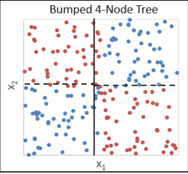
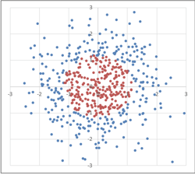
Limitations/Cautions
If categorical but not ordinal, tree algorithm needs levels to be ordered
Example: Deductibles 100, 500, 1000 as a text field will be ordered 100, 1000, 500.
Some interactions are difficult to find
Notes:
First one: First split won’t find red and blue
Second one: Need 2 (red/blue) but will get 9 – tic tac toe

Slide 23
A quick note on Ensemble Trees
I’ll fill this in if we need it

Slide 24
Appendix

Slide 25
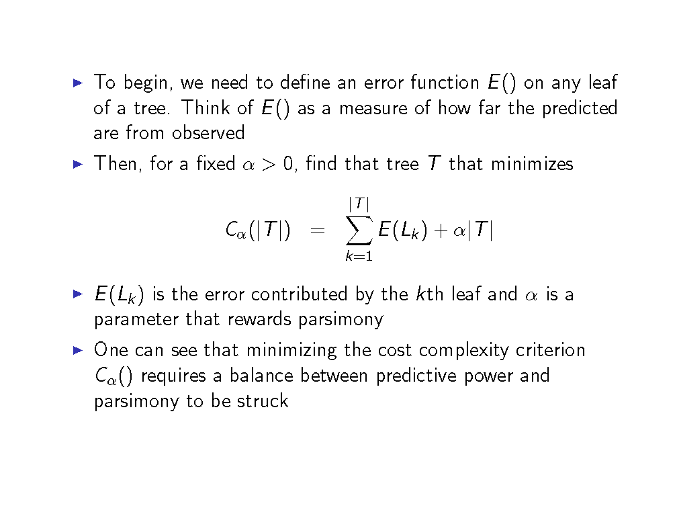
Stopping Criterion – Regression Trees

Slide 26
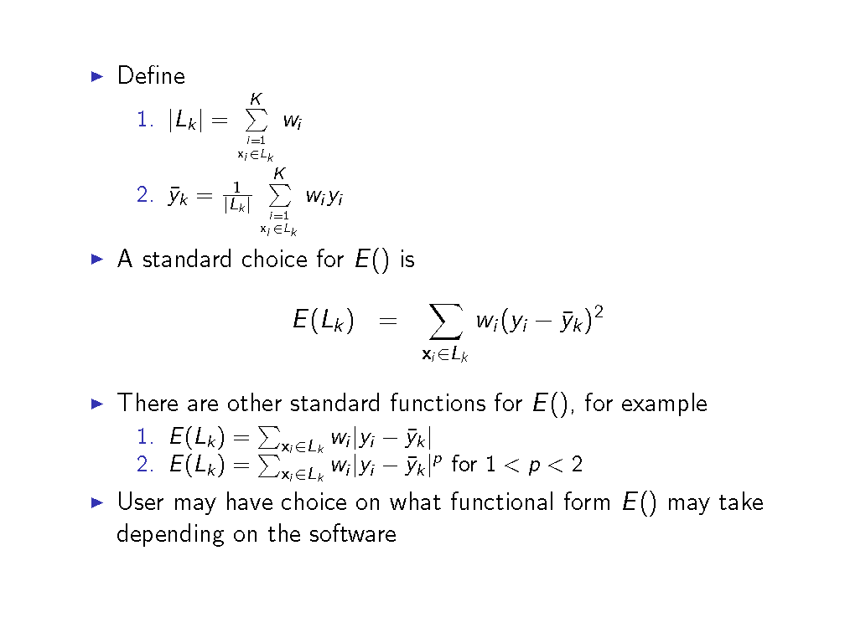
Stopping Criterion – Regression Trees (cont.)

Slide 27
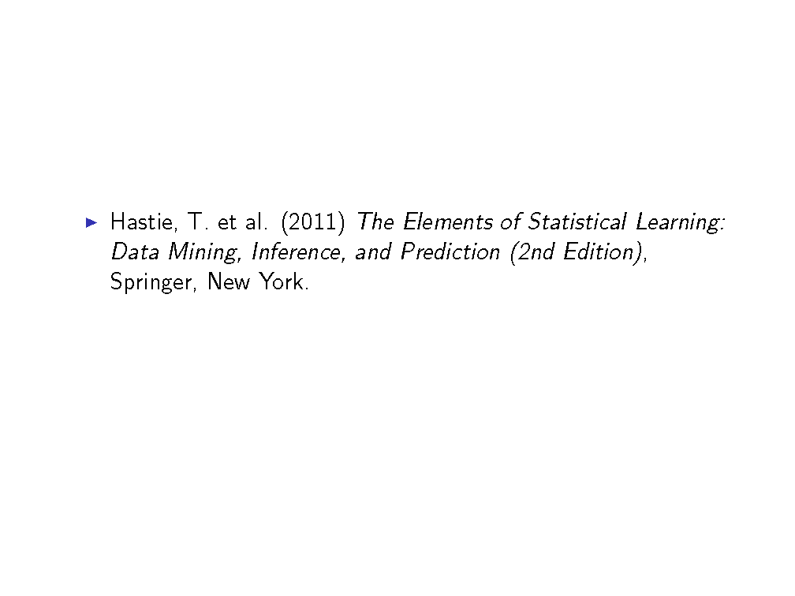
Bibliography

